Slide 1
Information Technology
Discipline
Client Meetings

Slide 2
Guidelines for Client Meetings
Be realistic about client meetings
You should see your client about four times this
semester
For the Requirements Determination Interview
For the R&A Document verification
For the client walk-through in week 12, to demonstrate (and possibly) install the system
At the presentation
Your supervisor does not normally meet with the client, but that is negotiable between the team and your supervisor

Slide 3
Guidelines for Client Meetings: Planning
On your first meeting with the client, try to establish the ground rules:
preferred mode of communication
frequency of meeting with your client
general client expectations
generally you will meet at the client’s business

Slide 4
Prepare well
Your client’s time is valuable - never waste it
Be well prepared for every meeting and interview
Give the client an agenda/meeting plan ahead of time
You must also be prepared to ask questions on the fly

Slide 5
Prepare well
The Secretary must take minutes about what was upon agreed, and suggested
Collect relevant documents:
If the interview is to gather information, try to ensure that you get samples of relevant documents if applicable
Let the client know ahead of time that you will be seeking to see, and possibly have copies of, relevant documents

Slide 6
Preparing the Interview Plan
Review systems analysis notes on interviewing techniques
Hold a group meeting to agree on an interview plan
Structure the interview plan as much as you can, but allow the flexibility for extra questions and some variation to the plan
It is strongly suggested, that you discuss your interview plan/questions with your supervisor

Slide 7
Preparing the Interview Plan
Start with what you already know
Work out what you want to know from there
Type up the interview plan (agenda)
Circulate to group members ahead of the interview
Give the client a copy ahead of time so that s/he can also prepare for the interview

Slide 8
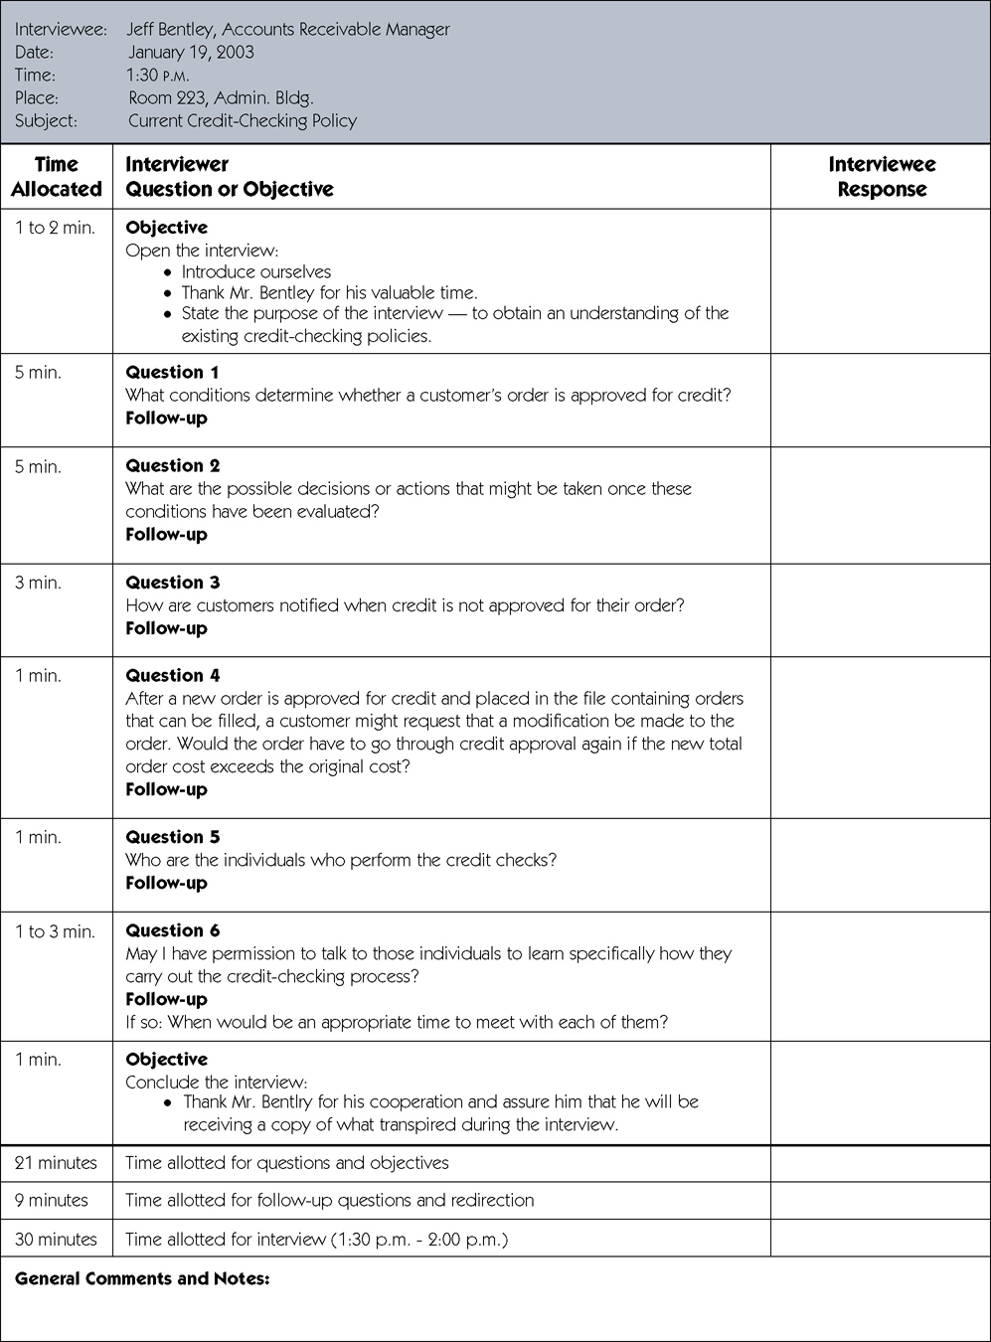
Sample Interview Guide
Notes:
8

Slide 9
Interview Questions
Guidelines:
Do not be afraid to ask ‘basic’ questions
The narrative in your R&A document must be clear to someone not familiar with the project
Use clear and concise language
Don’t include your opinion as part of the question
Avoid long or complex questions
Avoid threatening questions
Don’t use “you” when you mean a group of people
Notes:
9

Slide 10
Roles during the Interview
Who should attend the client meetings:
The whole team should attend the first client meeting
Subsequent meetings will depend on what needs to be discussed
Not everyone may need to be there, so use your discretion

Slide 11
Roles during the Interview
The Chairperson
Should ensure that the agenda for the interview is complete
May arrange the interview with the client
Is in ‘control’ or in ‘the chair’ during the meeting
Should probably be the current Activity Coordinator (team leader)
The Secretary
Creates and distributes agenda, and takes the minutes; then distributes the minutes afterwards
If the client is agreeable, record interviews

Slide 12
Conducting the Interview
Review any previous meetings, or the background to the project so far, before the interview
Make any necessary introductions
The Chairperson should thank the client for his time and then sums up the main purpose of the interview
Assure the client that the interview is confidential

Slide 13
Conducting the Interview
At all times assess whether you are getting
enough information (harder than it seems):
If not, ask for more information or an example of what the client means
Don’t be afraid to add extra questions but
come back to the plan afterwards
Allow the client time to answer
Also allow the client to ask questions
Don’t butt in when others are speaking; it is
poor etiquette – be patient

Slide 14
Terminating the Interview
Point out that the client will have an opportunity to review your understanding of the project via the R&A Document
Tell the client when you are likely to want to see him next
Obtain contact details of other members of the client organization who may need to be approached for information
Thank the client for his time

Slide 15
After the Interview
Hold a team meeting asap after the client meeting (so that the discussion is fresh in each member’s memory):
To review the information gathered
To discuss whether you have got all the information you need at this stage
To plan subsequent tasks based on this information
Write up the minutes and distribute them promptly to group members, the client and your supervisor

Slide 16
General Hints for Client Interviews
Be professional in every contact with your client
Be on time:
Time is money, as punctuality is a professional courtesy
Dress:
Casual is fine, but dress neatly and cleanly
Provide quality deliverables of all kinds, including little things like agendas and minutes

Slide 17
General Hints for Client Interviews
Communicate professionally and avoid
jargon
Be tactful and respectful of the client’s
business/organization:
Particularly when it comes to your client’s confidentiality

